Slide 1
Value of Youthwork and supporting Youthwork in the local community
Sharing some thoughts & ideas
Ben Verstreyden
Youthwork and Youth Policy consultant, Flanders

Slide 2
Different views on youth policy
Safe | Considerate | Participative
prevention: how to avoid risks & ‘misbehaviour’ of young people Protection Very directive, no consulation | Education, aid: how to help young people to develop Provision Listens, but takes decisions | Empowerment: how to create society together with young people Participation Invites to express views, looks for mutual points of view.

Slide 3
Ingredients of a powerful youth(work)policy
Integral: covering all domains of policy: housing, care, education …
Positive: policy and measures are based on the strengths and talents of young people, not on the possible risks
Interactive: systematic and intensive consultation with those involved and on the basis of equal partnership
Inclusive: the policy contributes to the development of all ch & y
Integrated and integral

Slide 4
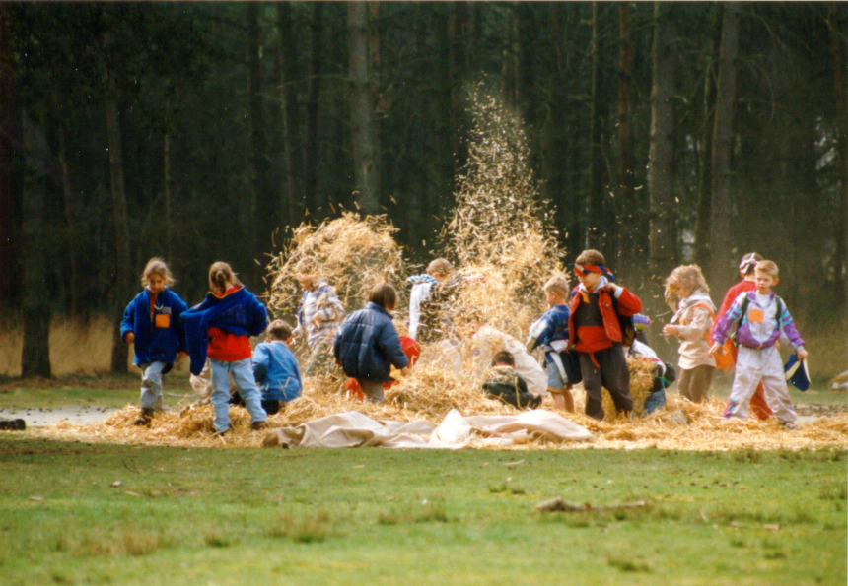
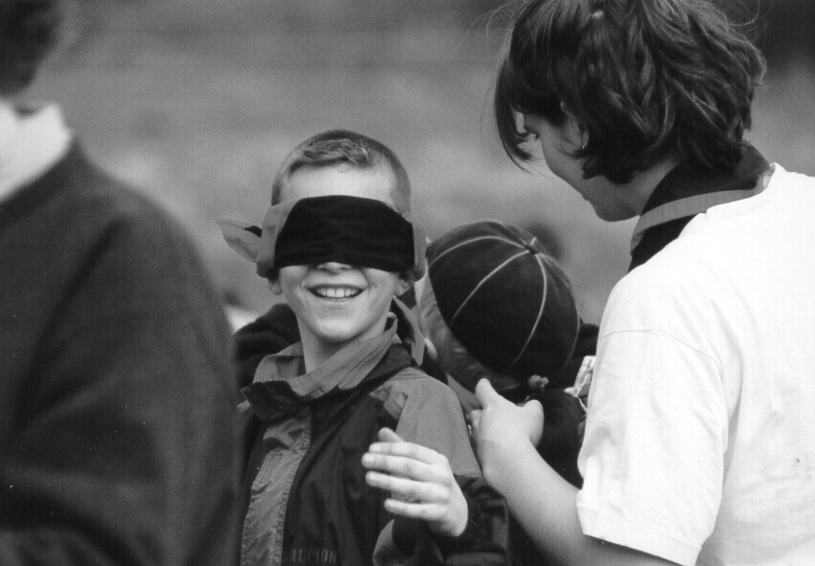
Youthwork

Slide 5
Youthwork
Emancipatory!
Children & youngsters CHOOSE to take part
Is process-orientated, more than result-orientated
Is a ‘socializer’, it builds very envolved civilians
A safe environment for experimenting: opportunity to develop talents, ideas. A place to practice with taking responsability …
The “best prevention you can buy”
Youthwork is/has to be FUN!

Slide 6
Value of playing
“Playing is an occupation one cannot take seriously enough.”
Jacques Yves Cousteau

Slide 7
The municipality/ Local Government

Slide 8
The municipality/Local Government
Facilitate! Don’t ‘take over’ (ownership)
Emancipate: make young people stronger
Work needs-orientated: start with questions, ideas, needs coming from the children and youngsters. (bottom-up)
Stay close to youngsters: requires a certain open attitude (participative), skills, knowledge)
Talk ‘with’ youth, not ‘about’ youth
Youth is not the “not-yet” part of society, they are fully part of it

Slide 9
What can you develop on a supra-local level?
Bonding
Supporting, training, capacity building for local volunteers
A channel for appreciation towards the local volunteers/workers
Identification with other initiatives so you don’t feel alone.
Deepening insights and quality, shared values
Securing continuity (to a certain degree)
It helps dissemination of “lessons learned”, also to other (policy) actors
Advocacy for the unique and valuable work that is being done in several communities

Slide 10
Possible threats, things to watch out for …
Too much professionalisation: drifting further away from the grassroot level
Diminishing feeling of ownership
Risk of creating a ‘straight-jacket’: not leaving enough space for new or diverse initiatives, or sometimes controversial ideas

Slide 11
So, now …
In the words of Captain James T. Kirk,
“Boldly go where no man has gone before
and seek out new worlds and new civilizations …”

