Slide 1
White -Yellow Cross of Flanders and Crucea Alb-Galbena of ROMANIA Hendrik VAN GANSBEKE, general coördinator
Decentralized cooperation BELGIUM-ROMANIA : 4th Forum
Leuven, October 26th, 2013

Slide 2
Mission and Vision White-Yellow Cross in Flanders
Mission statement: The W-Y-C realizes accessible, high-quality and dignified nursing care and complementary services at the patient’s home
W-Y-C offers added value
on an individual patient’s level: a personalized and integrated supply of care; patients rights and care directed by patient
on organizational level: initiating and creating innovative care
Important values:
autonomy – justice – solidarity – ‘do not harm’ – expertise – Christian inspiration
solidarity – confidence – co-operation
respect – role integrity – responsibility – quality of care – learning organization

Slide 3
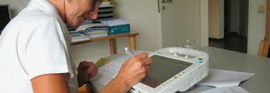
Federation of White-Yellow-Cross of Flanders Home Care Nursing
Nursing care at home 153.114 patients in 5 provinces in Flanders
6151 (4871 nurses) Employees
RIZIV income – 242.361.027 euro
Representation of W-Y-C towards governmental authorities and other organizations
Negotiations
Preparation of policy for W-Y-C (e.g. strategic plan)
Supporting services / coördination for the provinces
Research/study – informatics – HR – finances - Quality

Slide 4
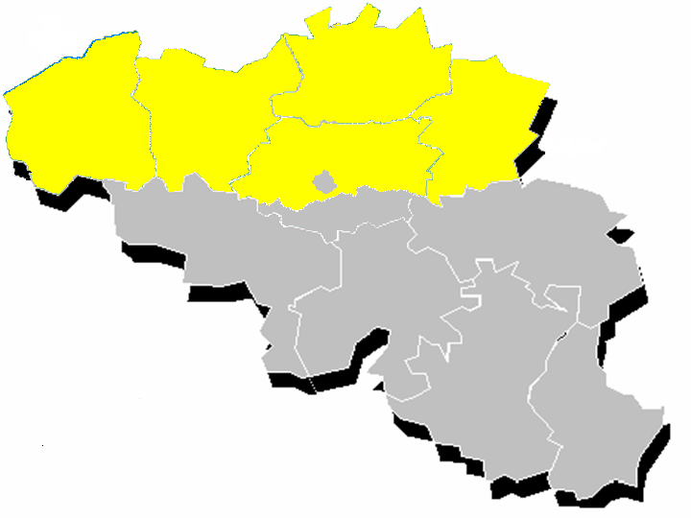
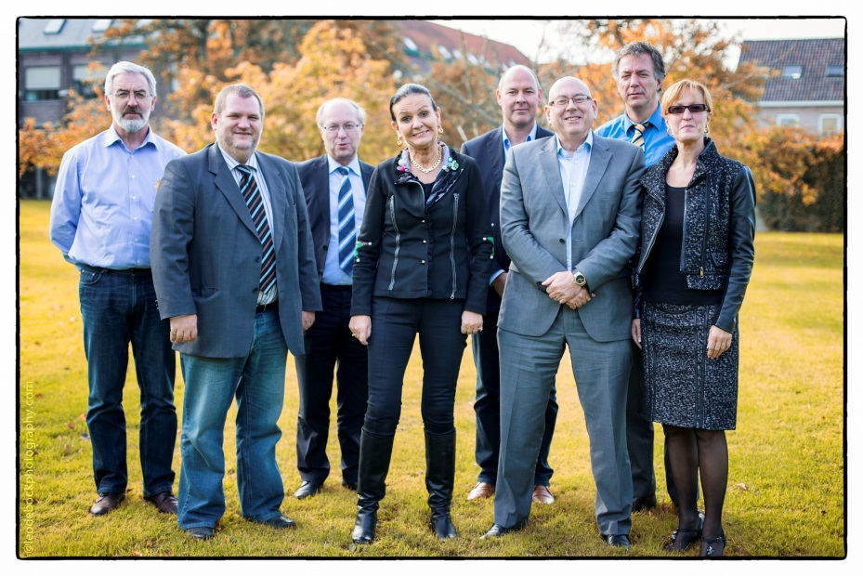
Flemish Region
One brand name:
“White-Yellow Cross”
5 (+ 1) autonomous Organizations
Belgium

Slide 5
Nursing at home & the patient
Home care will be possible, when there is a relation with the patient
The patient will let to be touched by a nurse ‘in (a way of) being’
It’s not the patient himself who is an autonomous person on his one; it’s the relation with the patient, that makes that the patient is the central person

Slide 6
WYC in Romania – Crucea Alb-Galbena
In 1996 asked by the Flemish Minister-President – CDP – to get involved in an supportive initiative for the healthcare education in Romania in the post-revolution period – teaching what Home Care Nursing meant in Flanders – starting an look-a-like initiative in Home Care Nursing in Romania
Out of the nursing education in Romania
Mariuca Ivan and a lot of collegues – supported by experienced WYC leaders – Dr. D. De Coninck and Ludo Geys and collegues (f.i. Luc Bijnens)
2003 – real teams started to deliver homecare services

Slide 7
Nursing at home & home care in Romania
Installing the homecare services concept into the Romanian legislation
Years of intensive collaboration with the Ministry of Healthcare and CNAS
First functioning autorisation – first accreditation certificate – first contract for delivering home care services with CASMB and OPSNAJ
Services based on Loi 34
Integrated and multidisciplinary home care
Important local homecare projects
Participate in the further evolution of the national health system and the home care concepts
Ongoing concern

Slide 8
Crucea Alb-Galbena in Romania
Bucuresti Fundatia Marioara IVAN Federatie Wit-Gele Kruis van Vlaanderen
Bucuresti CAG Marioara IVAN Federatie Wit-Gele Kruis van Vlaanderen
Targoviste CAG dr. Sorin STOICA Wit-Gele Kruis van Limburg
Sibiu CAG Michaela DAN Wit-Gele Kruis van Vlaams-Brabant
Baia Mare CAG Lucretia TITIRCA Wit-Gele Kruis van West-Vlaanderen
Focsani –Vrancia CAG Ioan CONSTANTA Wit-Gele Kruis van Oost-Vlaanderen
Constanta CAG Florica UDMA Wit-Gele Kruis van Antwerpen
Buzau CAG Christina VASILE Provinciebestuur Oost-Vlaanderen
Since 2011 new initiatives are starting
Deva CAG Monalisa PANAITESCU CAG Fundatia Bucuresti
Slatina CAG Magdalena REZEANU CAG Fundatia Bucuresti
Autonomous managed organisations – selfsupportive
Hard economic situation
Need of new young people that can garantee continuity for the initiatives!

Slide 9
WYC and CAG
Still supporting
Worry about the continuity
Believe in quality and solidarity
Believe in social profit
Worry about commercialisation of healthcare
Believe in the strong and involved
Need for networking and collaboration with organisations with similar mission and vision
Continuing the support!

Slide 10
More information
www.wgk.be
Chairman: Luc Van Gorp
luc.van.gorp@vlaanderen.wgk.be
General coördinator: Hendrik Van Gansbeke
hendrik.van.gansbeke@vlaanderen.wgk.be
www.cag.ro
Director: Mariuca Ivan
mariucaivan@cag.ro

