Slide 1
The 5th Forum
Decentralized Cooperation Belgium-Romania
Iași, Romania, November 05-07, 2015
Workshop no. 14 – FIRE SAFETY
THE FIREFIGHTING SYSTEM
IN ROMANIA
Presentation by GATEJ Marius from General Inspectorate for Emergency Situations (Romania)

Slide 2
Why should we talk about the ROMANIAN FIREFIGHTING SYSTEM at the FORUM?
Many activities to support the voluntary firefighting system in Romania;
Need to understand the emergency system of Romania;
Desire for further cooperation Be-Ro into the fire safety area.

Slide 3
THE FIREFIGHTING SYSTEM IN ROMANIA
The relationship between
Firefighting & Emergency situation
concepts

Slide 4
THE FIREFIGHTING SYSTEM IN ROMANIA
2004 - new concepts and a new frame for the emergency response was created;
The EMERGENCY SITUATION was defined;
The National Emergency Management System (NEMS) was adopted by law;
Where can we find now the firefighting concept into the NEMS?

Slide 5
The National Emergency Management System (NEMS)
The National Emergency Management System is a nationally owned mechanism of multi-stakeholders which provides coordination and response in case of emergencies, and serves as an advocate for prevention and disaster risk reduction at different levels.

Slide 6
National Emergency Management System (NEMS)
NEMS’ components:
  National Committee for Special Emergency Situations
  Department for Emergency Situations and National Centre for Command and Coordination of Interventions
  Committees for emergency situations;
  General Inspectorate for Emergency Situations;
  Professional (County inspectorates) & volunteer intervention structures;
  Emergency Operation Centers
  Incident Commander

Slide 7
NEMS
GIES
NCSES
NOpnlC
Emergency
Structures
(professionals & specialists)
MCES
National level
MEOpveC
County level
CIES
Emergency support
functions
CCES
COpnlC
County Emergency Services
(professionals)
Local level
OpveC
LCES
Local Emergency Services
(volunteers)

Slide 8


ACTIVATION PRINCIPLES
Mayors
County
(Regional)
National
Request to:
Emergency services
MIA & RO Army
NGO’s
Request to
6
Request to
International
Notes:
Civil Emergcy Planning
Here you can see the speciality of our system. Each or the most Municipality in our country has a local fire brigade and a civil defence organization. It is also the same on cantonal level, so they are able to engage their own means before they request the means of the Swiss Armed Forces.
Sequence of engagement
Sequence of engagement during active service:
Local fire brigade / civil defence organization;
Regional fire brigades / regional emergency services / regional civil defence rescue formations;
Military units (primarily rescue troops, disaster relief regiment 1 and secondly other units such as engineers, medical units and air force.

Slide 9
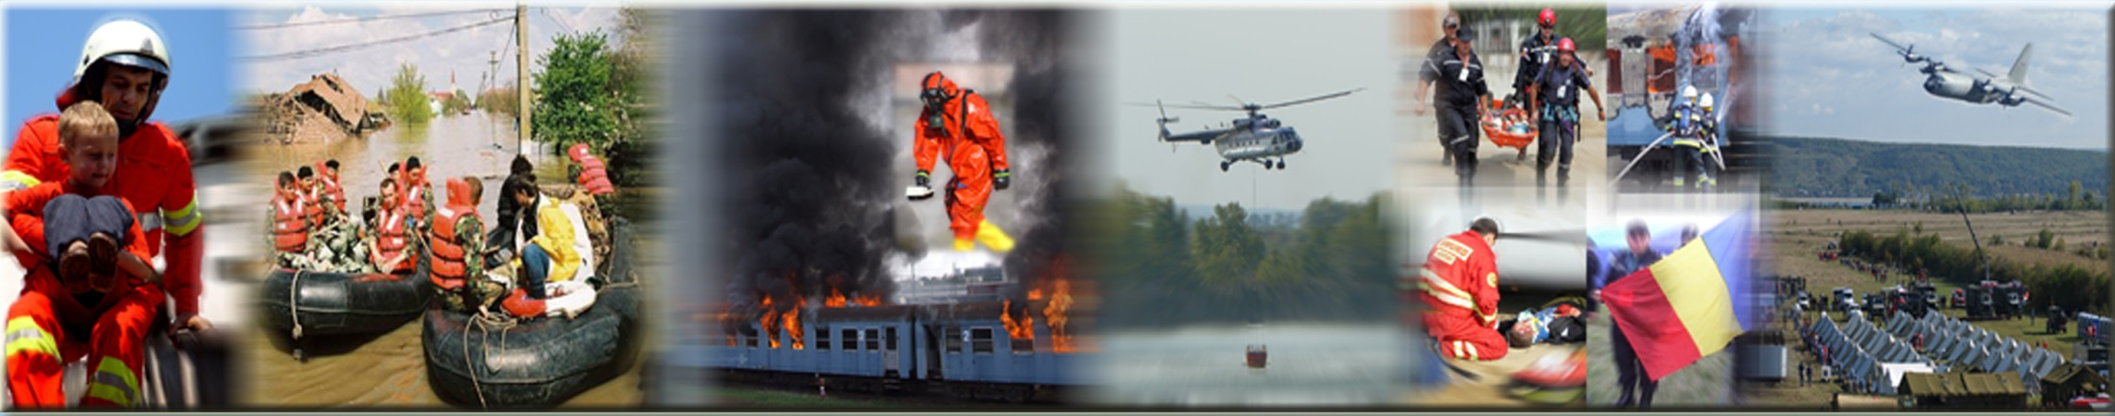
R O M A N I A
GENERAL INSPECTORATE FOR EMERGENCY SITUATIONS
(GIES)

Slide 10
General Inspectorate for Emergency Situations (GIES)
the result of merging of Civil Protection Inspectorate and Military Firefighters Corps;
specialized body of the Romanian Ministry of Internal Affairs;
responsible for coordination of all organizations involved in emergency situations management;
Is part of The National Emergency Management System (NEMS).

Slide 11
ORGANIZATIONAL STRUCTURE
OF THE GIES
GENERAL INSPECTOR
FIRST DEPUTY OF
GENERAL INSPECTOR
DEPUTY OF
GENERAL INSPECTOR
NATIONAL
OPERATIONAL
CENTER
PREVENTION INSPECTION
LOGISTICS
SECTION
EUROPEAN
AFFAIRS
AND
INTERNATIONAL
RELATIONS
SERVICE
CONTROL
SERVICE
OPERATIONAL
CENTER
FIREFIGHTING
SECTION
CIVIL
PROTECTION
SECTION
JUDICIAL AND
LAW
SERVICE
HUMAN
RESOURCES
MANAGEMENT
SECTION
STANDING
TECHNICAL
SECRETARIATE
OF THE NCSES
SECRETARIAT
FINANCIAL
SECTION
COUNTY
INSPECTORATES
41
PUBLIC
RELATIONS
OFFICE

Slide 12
GIES’ SUBORDINATED UNITS
41 COUNTY INSPECTORATES FOR EMERGENCY SITUATIONS and
INSPECTORATE FOR EMERGENCY SITUATIONS OF BUCHAREST
with 313 intervention subunits
SPECIAL UNIT FOR INTERVENTION IN EMERGENCY SITUATIONS
SCHOOL FOR CIVIL PROTECTION AND FIREFIGHTERS NON-COMISSIONED OFFICERS BOLDEŞTI
NATIONAL CENTER FOR FIRE SECURITY AND CIVIL PROTECTION
NATIONAL TRAINING CENTER FOR EMERGENCY SITUATIONS MANAGEMENT
CENTER FOR COMMUNICATIONS AND INFORMATICS
LOGISTICS BASE
MAINTENANCE FACILITY FOR INTERVENTION MEANS
NATIONAL MUSEUM OF FIREFIGHTERS
STORAGE FACILITIES

Slide 13
Local co-ordination
The overall co-ordination belongs to County Inspectorates for Emergency Situations

Slide 14
County Emergency Situation Inspectorates organizational chart
Chief
inspector
Secretariat
First deputy
Operational center
Intervention
units
Deputy
Prevention
Fire
prevention
Civil
Protection
Logistic
Law
adviser
Human
resources
Others

Slide 15
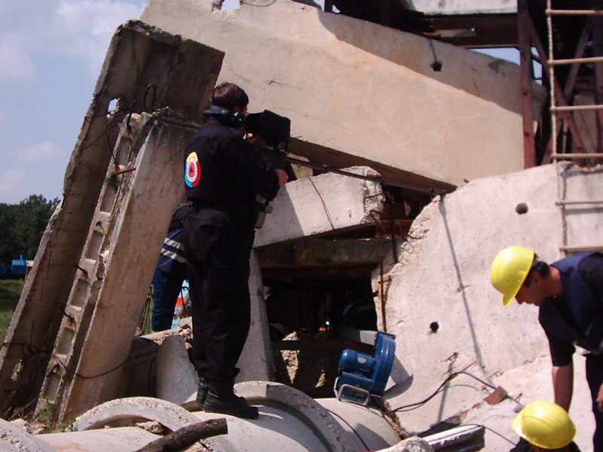
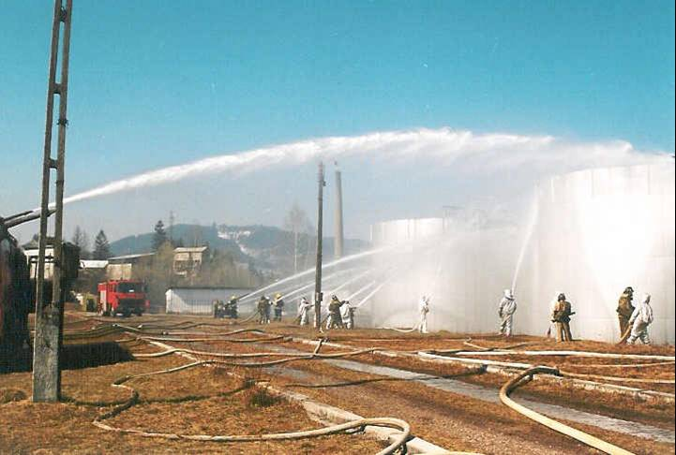
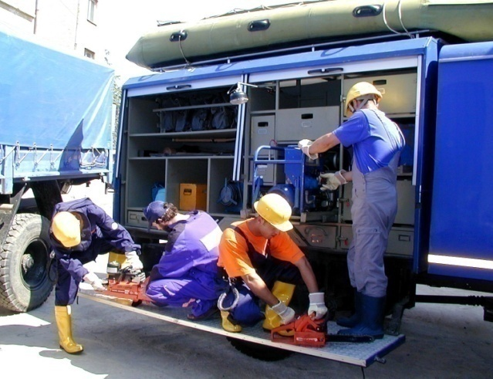
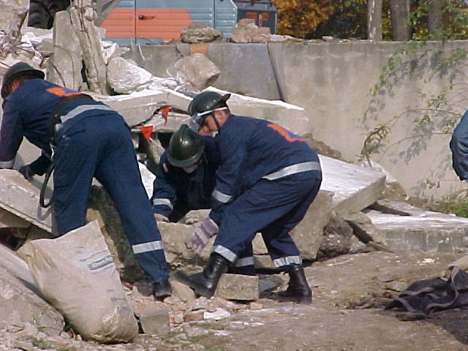
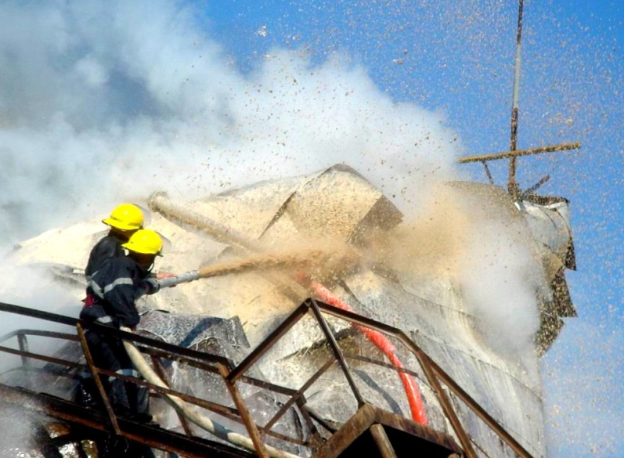
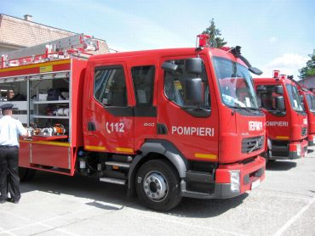
GIES - Missions
Urban S&R
Firefighting
Notes:
In accordance with its statutory duties the GIES and it’s subordinated units have the following tasks:
Firefighting
Recovery following natural disasters
Water rescue
Chemical and environmental rescue
Technical rescue
Height rescue
Medical rescue
Fire prevention
Physical excellence
Publishing
Firefighting:
To identify the fire status;
To perform extinguish and other rescue operations;
Safely carry out extinguish operations;
Proper use of equipment;

Slide 16
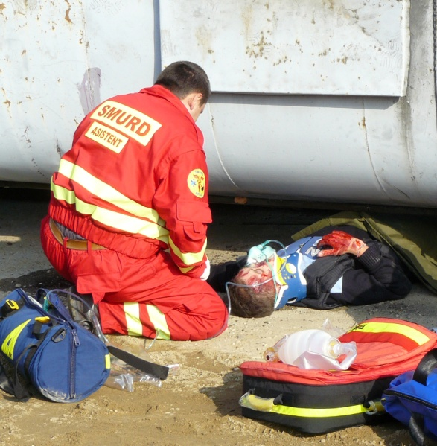
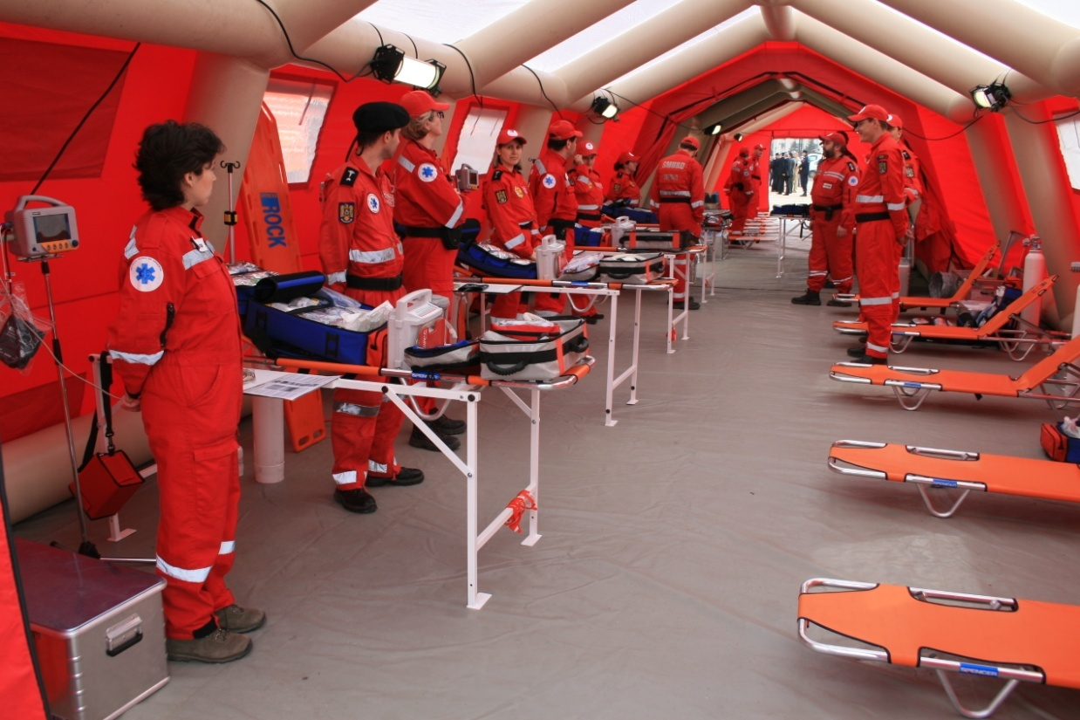
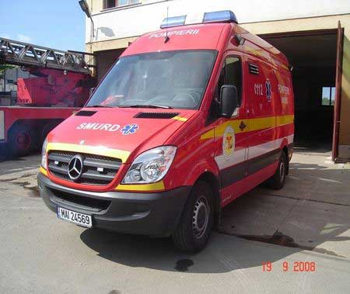
GIES - Missions
First medical aid

Slide 17
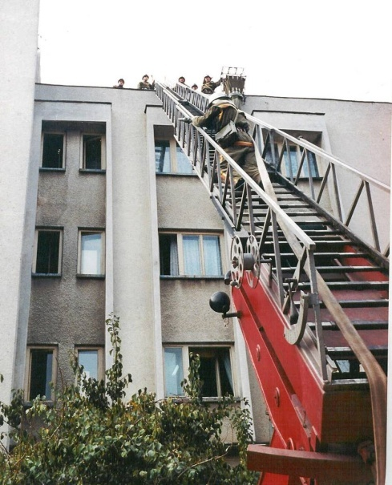
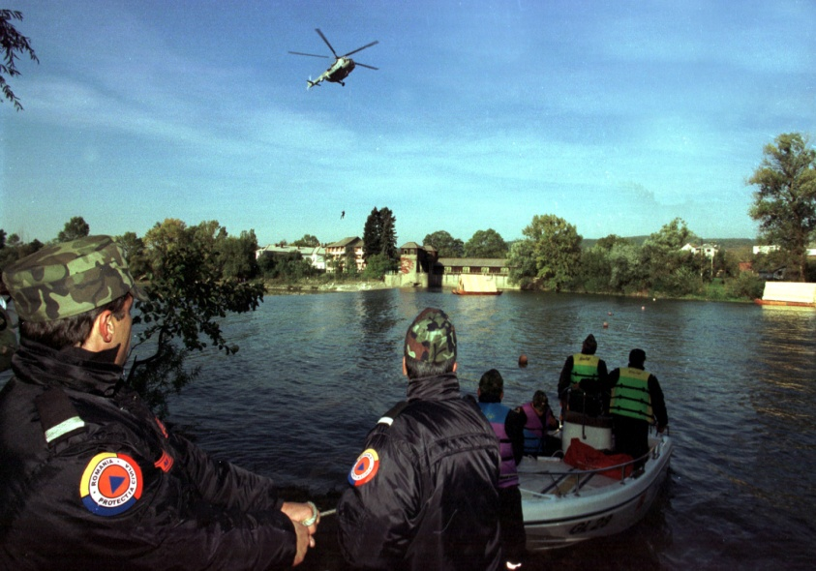
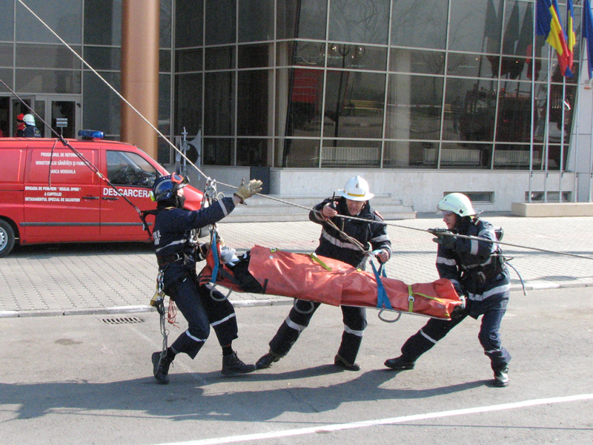
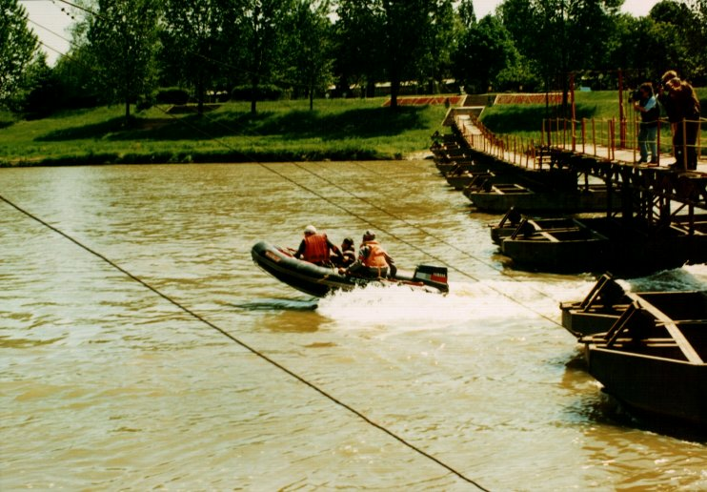
GIES - Missions
Heights rescue
Water rescue
Notes:
Water rescue
Life support of victims in flooded areas & rescue ops;
Scuba diving rescue operations & clearance;
Other work requiring the use of diving techniques or water vessels;
Height rescue
To assist the wounded in places where access is difficult, above and under the ground level;
To combine rescue operations with mountain climbing techniques;

Slide 18
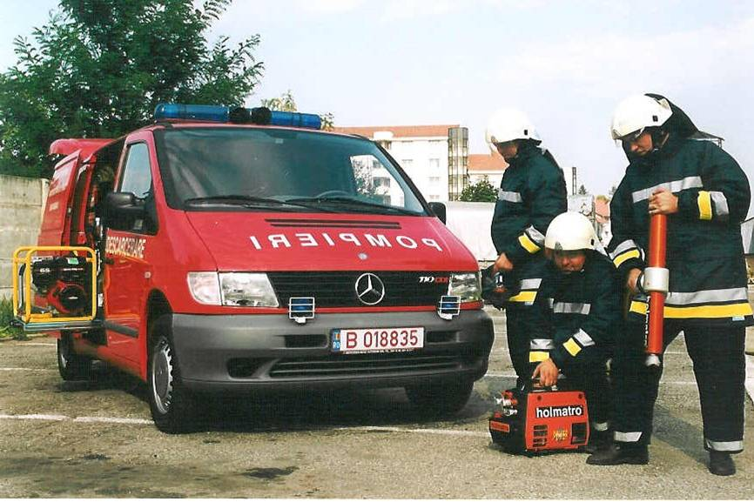
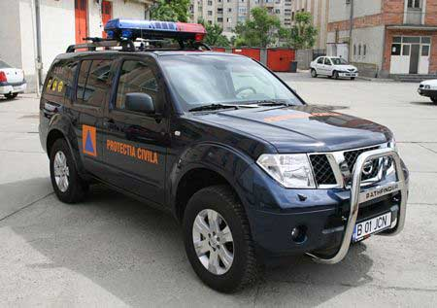
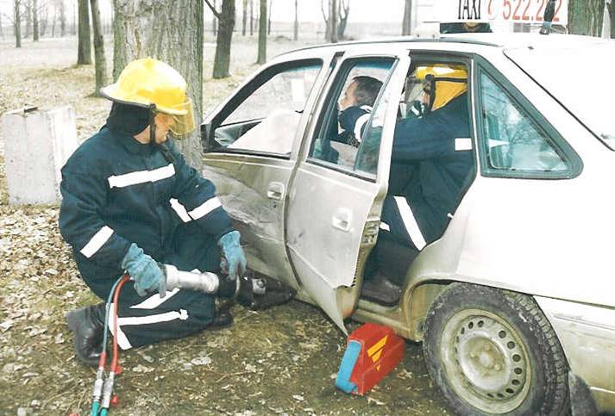
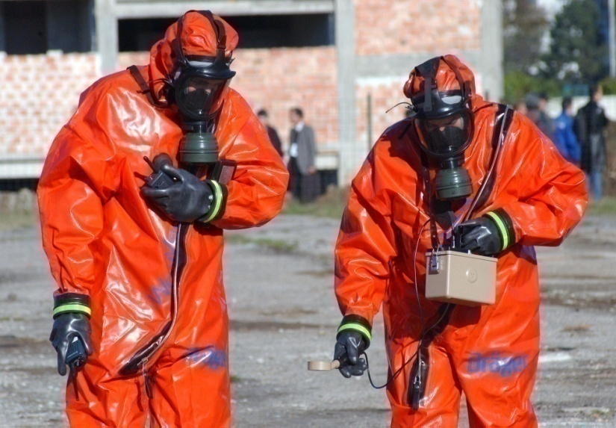
GIES - Missions
Technical rescue
Extrication
CBRN reconnaissance
and decontamination
Notes:
CBRN tasks
Establishing the safety areas;
detection, identification and control of chemical weapons;
evaluation of the extent and hazardous level in contaminated areas;
decontamination ops;
NBC rescue operations;
Tehnichal rescue tasks
Identify & assess the event status;
Establish the appropriate resources;
Perform rescue operations: hydraulic, pneumatic, cutting, demolishing and lighting equipment;

Slide 19
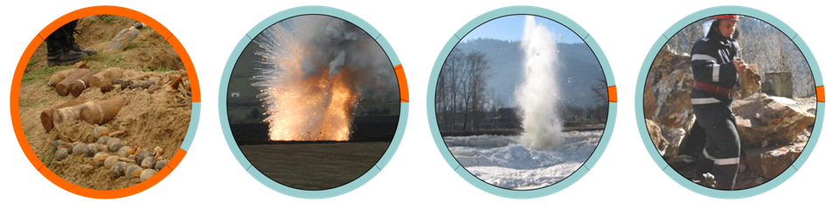
GIES - Missions
PYROTECHNICAL MISSIONS
SEARCHING, DETECTION
AND TRANSPORT
OF UNEXPLODED
ORDNANCE
UNEXPLODED
ORDNANCE
DESTRUCTION
ICE DAM
DESTRUCTION
UNBLOCKING ROADS
DUE TO ROCKFALLS
Notes:
19

Slide 20
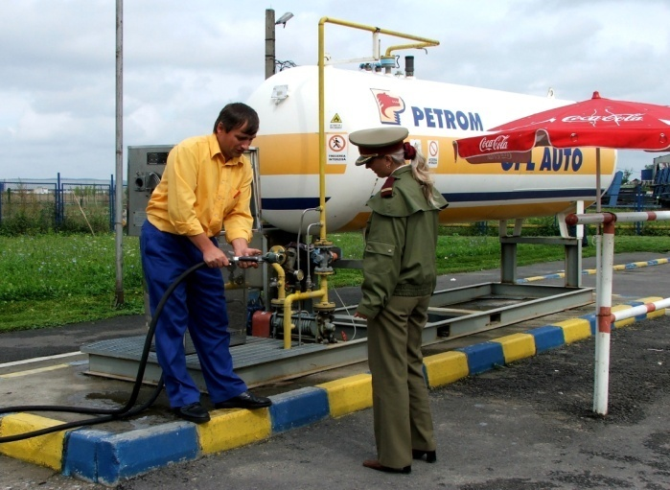
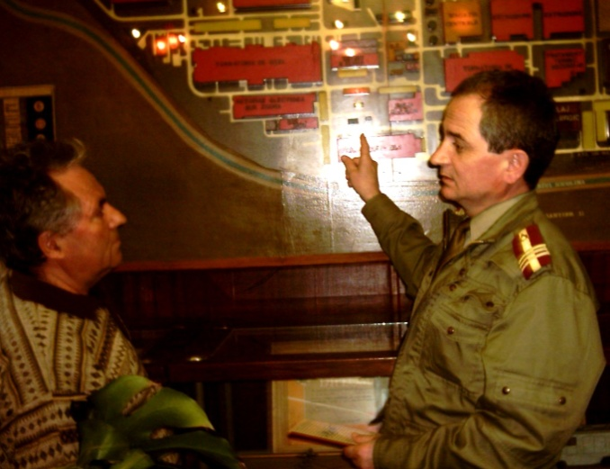
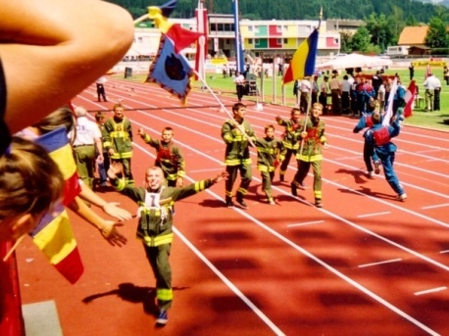
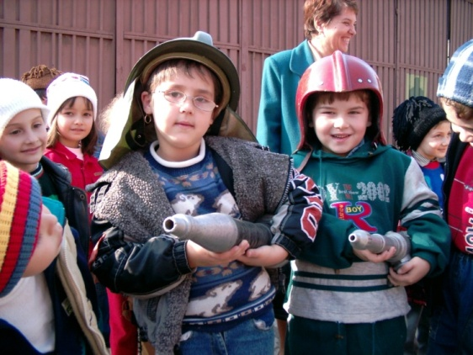
Preventive and protection measures
Risk & vulnerability analysis;
Control and inspections;
Authorization & certification;
Training and exercising;
Education;
Public information;
Early warning systems;
Sheltering & mass care;
Evacuation.

Slide 21
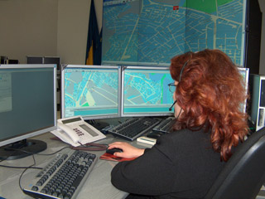
Internal Cooperation
Specialized bodies of the MIA – police, gendarmerie, aviation
Special Telecommunications Service (STS)
  Provider of 112 single emergency number
  Backbone for emergency communications at national level
Ambulance / Ministry of Health
Other ministries – Defense, Environment, Transportation, etc.
NGOs;

Slide 22
INTERNATIONAL COOPERATION
  GIES – National Contact Point cu specialized international organizations:
    ERCC – Emergency Response Coordination Center
    NATO / EADRCC – Euro-Atlantic Disaster Response Coordination Center
    UN-OCHA – United Nations Office for the Coordination of Humanitarian Affairs
    INSARAG national focal point – International Search and Rescue Advisory Group

Slide 23
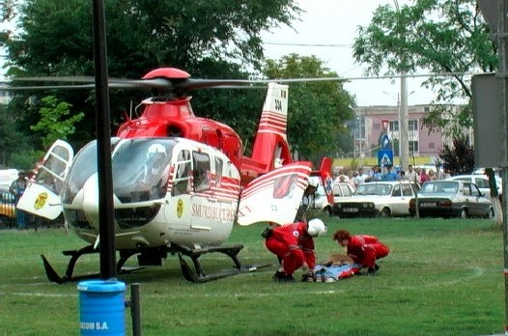
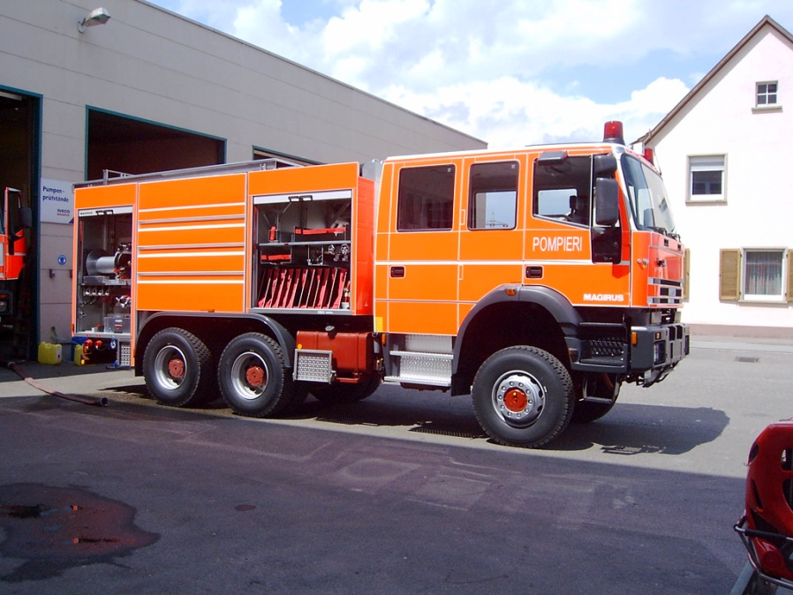
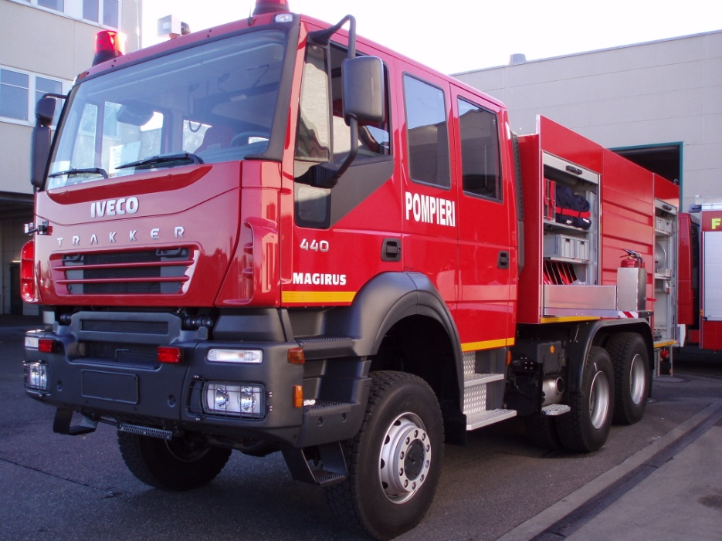

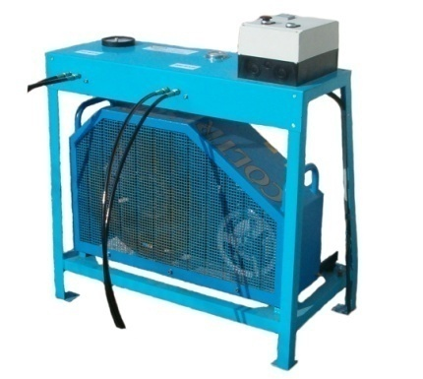
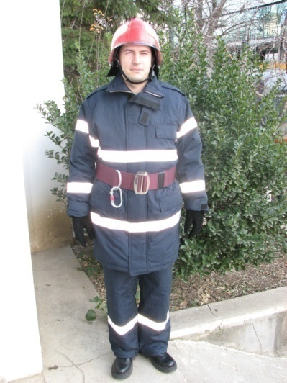
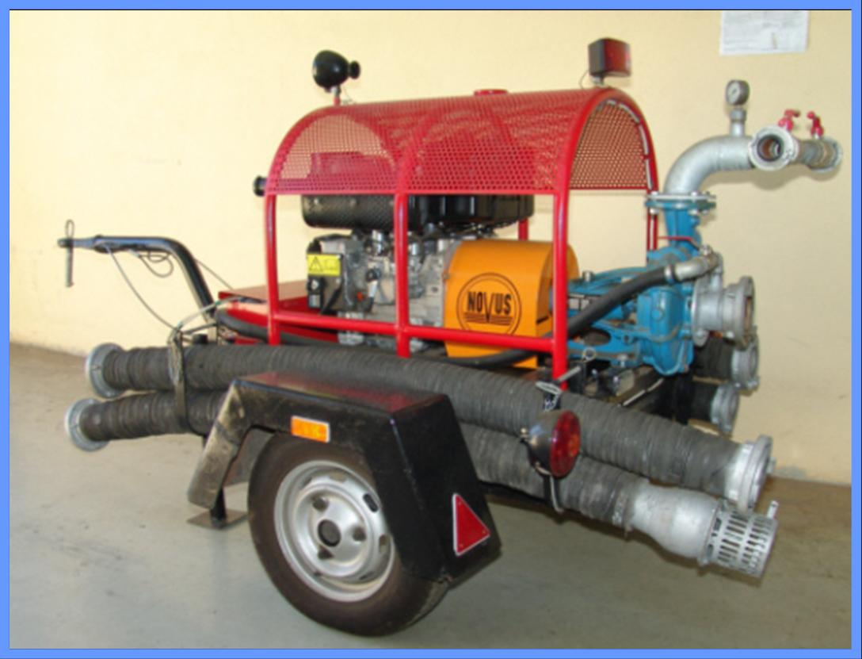
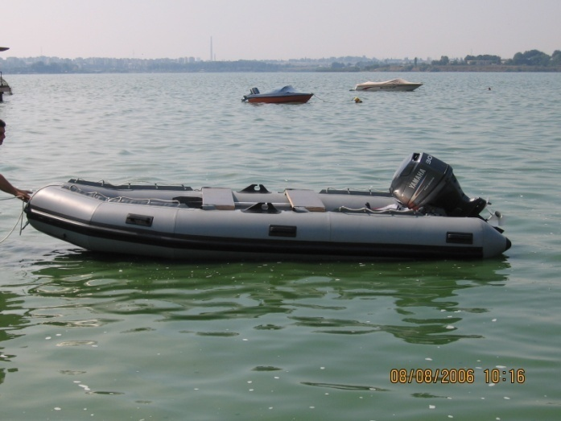
Equipment & funding

Slide 24
Voluntary Emergency Services – V.E.S.
Mayor’s responsibility;
Organizational principles:
  Area of responsibility;
  Number of population;
  Community classification;
  Types of risks;
  Water resources

Slide 25
Voluntary
Emergency
Services
Mayor
Local council
Head
Prevention
branch
Intervention
branch
Formation
Criteria:
5-10’ alert;
10’ response;
30’ response other villages.
Firefighting
Teams
Specialized
Teams

Slide 26
Voluntary Emergency Services – V.E.S.
Categories of VES
From the 1st category (only specialised personell – prevention and/or intervention, without means of intervention: trucks, pomps etc)
^{To}
The 5th category (ad list two teams and 2 fire trucks)

Slide 27
Voluntary Emergency Services – V.E.S.
THE TRAINING OF THE VOLUNTEERS
Their own training facilities
or
The CIES’ centres of training (protocols needed)

Slide 28
Voluntary Emergency Services – V.E.S.
DUTIES OF VOLUNTEERS FIREFIGHTERS
To respect the Regulation of Organization and Functioning;
To participate at the training activities;
To fulfill the tasks ordered during the interventions.

Slide 29
Voluntary Emergency Services – V.E.S.
RIGHTS OF VOLUNTEERS FIREFIGHTERS
Training programs and free transportation, accommodation and food during the trainings;
Insurance paid by the commune;
Annual medical examination;
Uniform and protection equipment;
Payment for the time spent during the interventions and trainings.

Slide 30
“Train-the-trainer”
Opinion about the project;
Visiting Campus Vesta (people, facilities, programs).

Slide 31
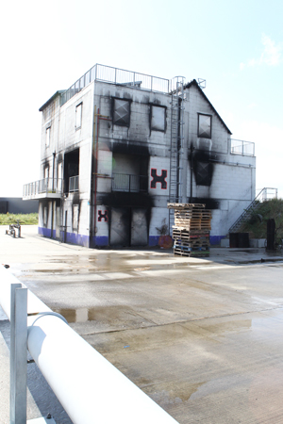
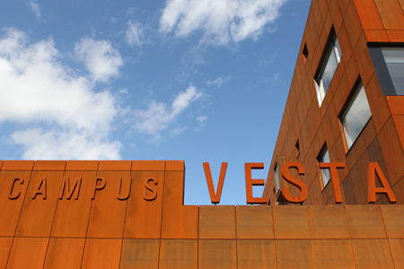
“Train-the-trainer”

Slide 32
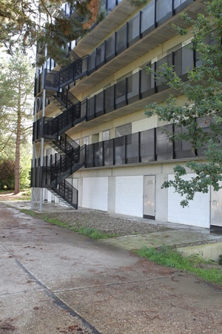
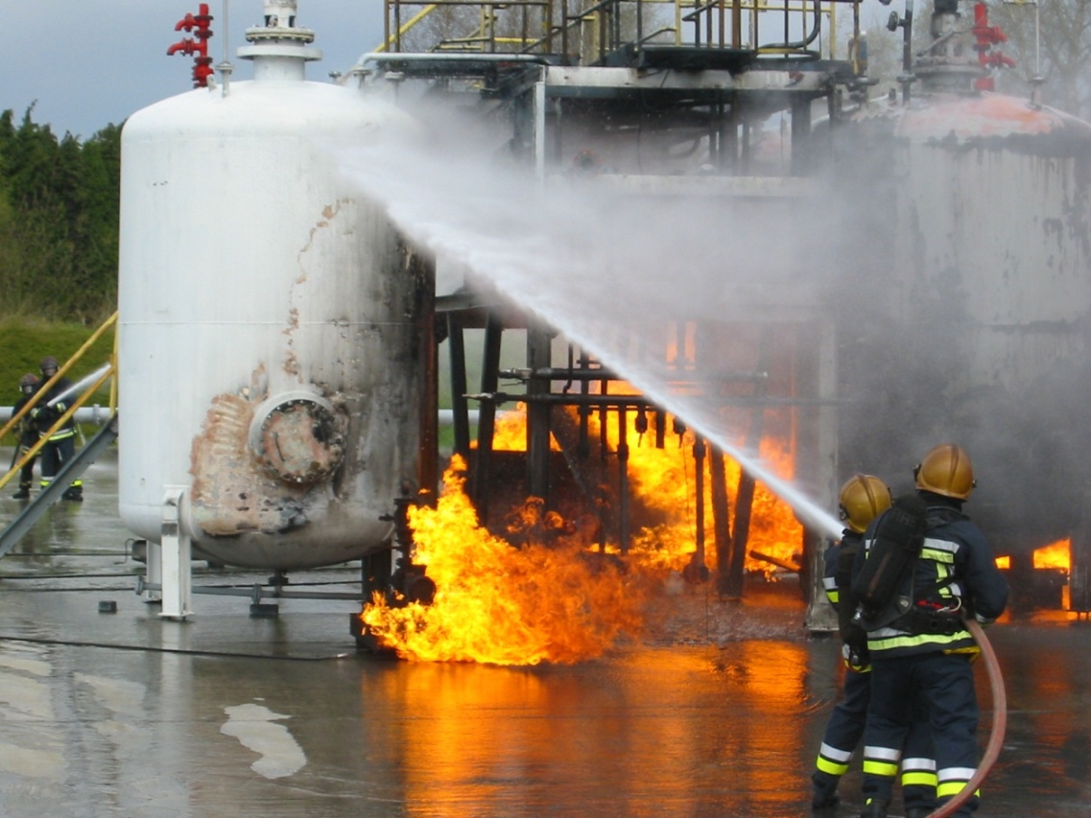
“Train-the-trainer”

Slide 33
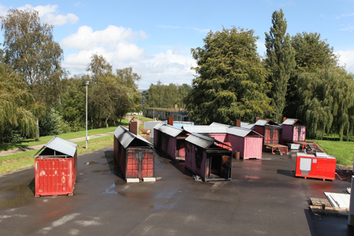
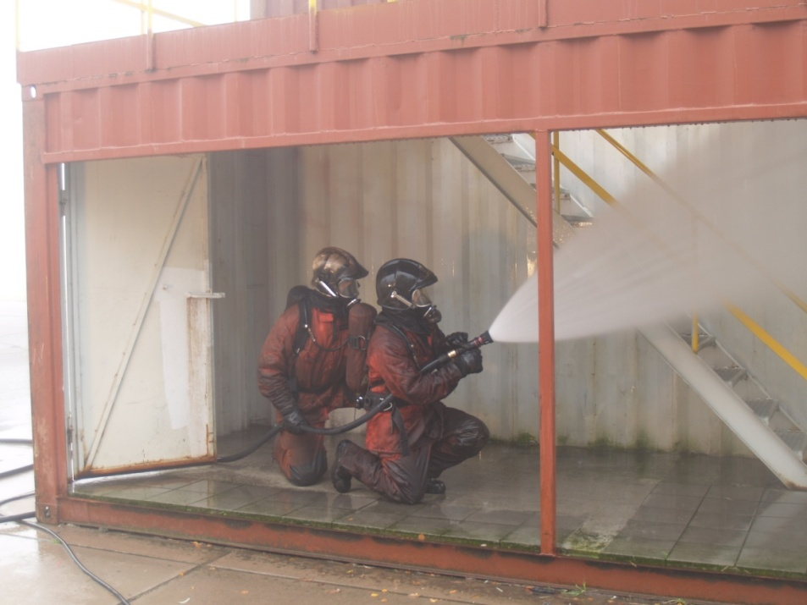
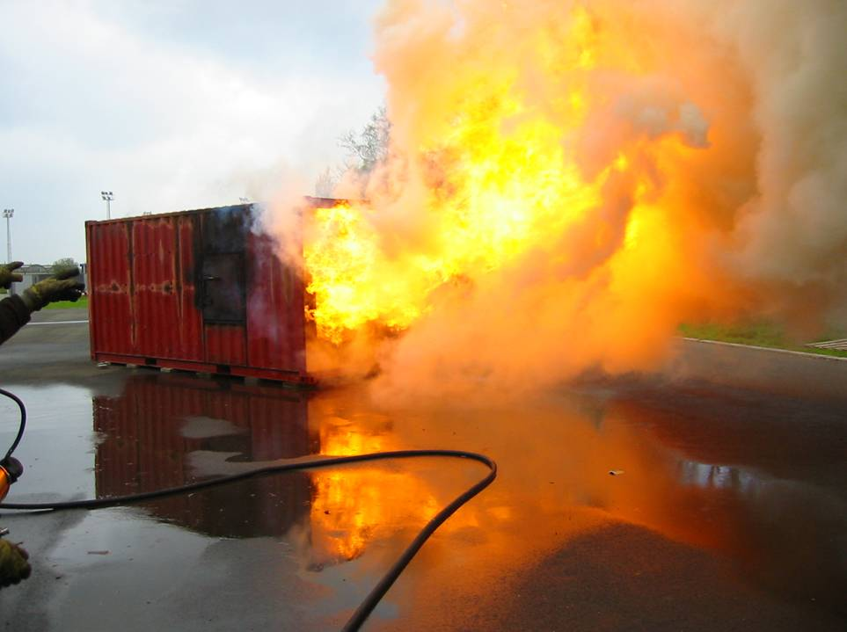
“Train-the-trainer”

Slide 34
CONCLUSIONS
“Voluntary” as a concept:
Belgium vs. Romania

Slide 35
ANY QUESTIONS ?

Slide 36


THANK YOU
FOR YOUR ATTENTION!
General Inspectorate for Emergency Situations
46 Banu Dumitrache street, District 2
BUCHAREST
phone: 0040 21 232 9586
fax: 0040 21 242 0990
e-mail: igsu@mai.gov.ro
web: www.igsu.ro

