Slide 1
Towards an Erasmus+ Project
Train the trainer

Slide 2
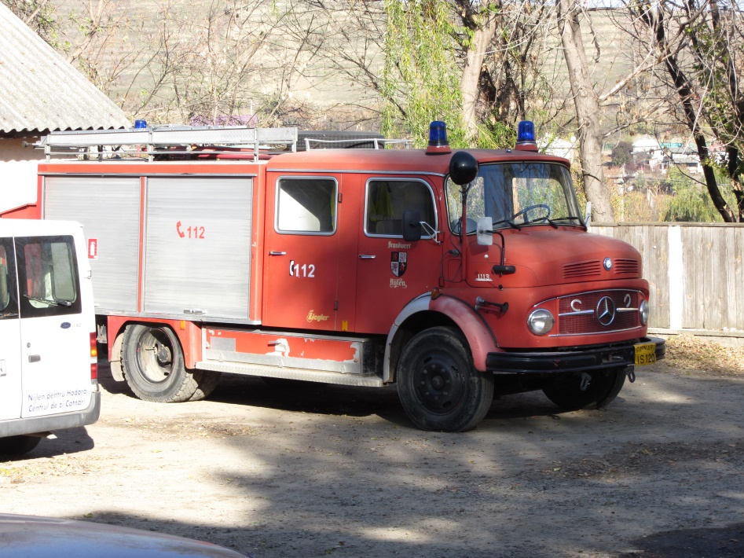
Belgian commitees are transporting fire-trucks and materials to the Romanian twinning villages
Nijlen voor Hodora to
SVSU Cotnari
Geel to
SVSU Slatina-Timis

Slide 3
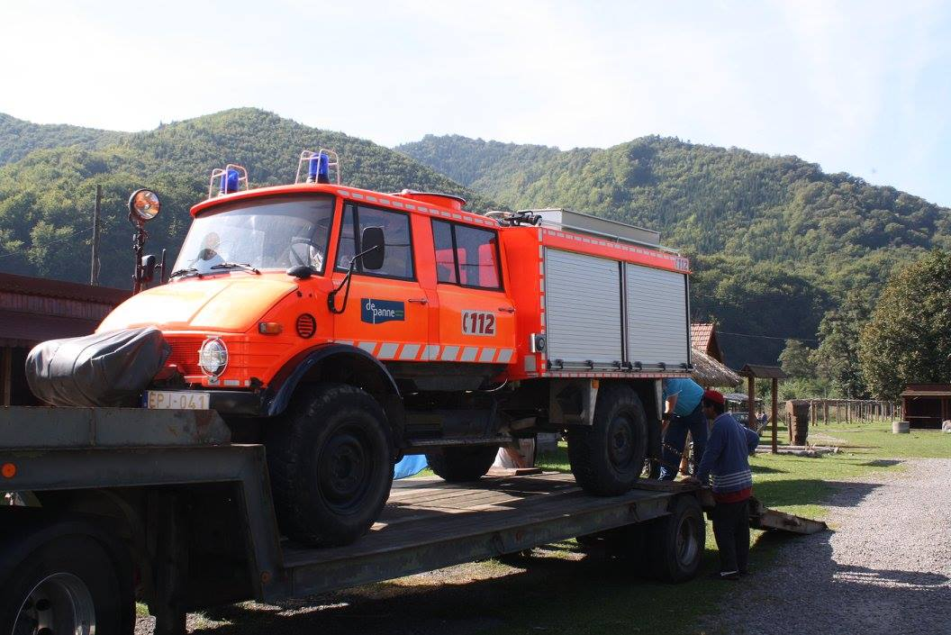
Eeklo to Prisacani De Panne to Rastolita Kasterlee to Murghesti, Balen to Ladesti and many more…..

Slide 4
Fire fighting equipment delivered

Slide 6
Training SVSU teams

Slide 7
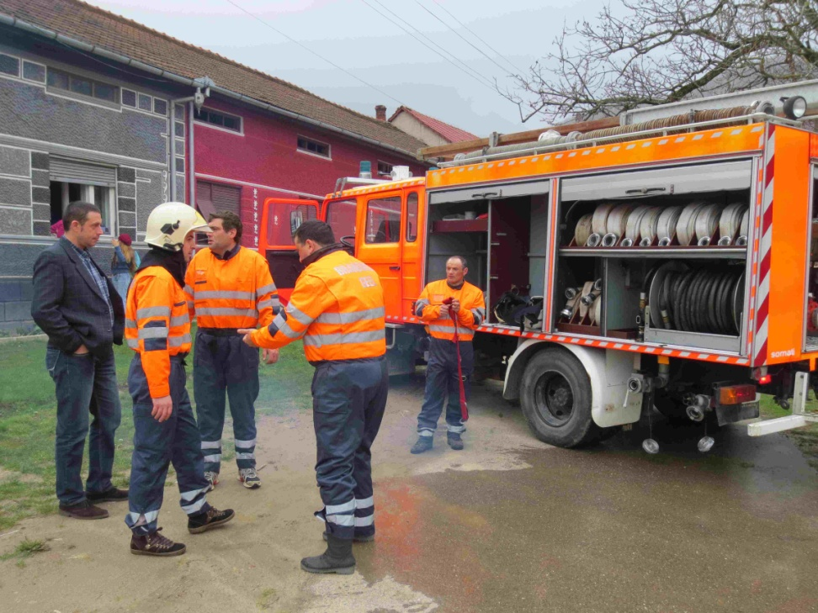

Slide 8
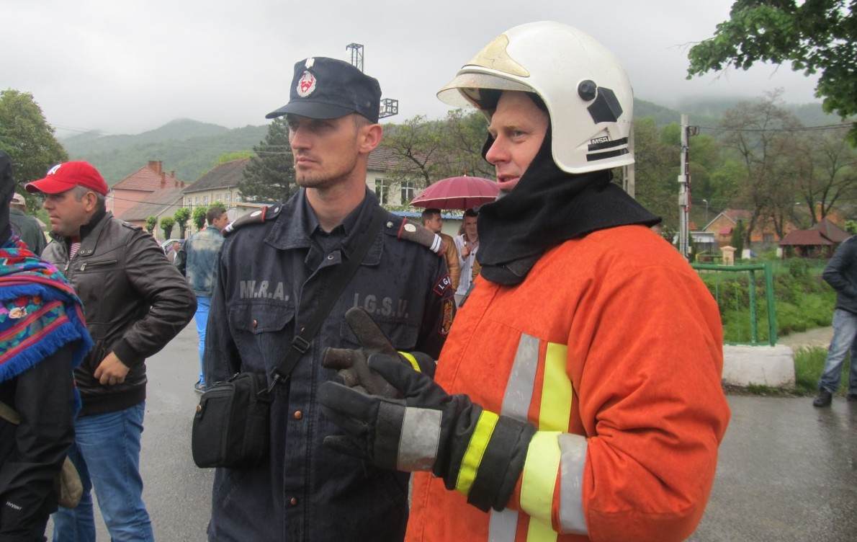
Training SVSU and ISU together

Slide 9
Difficulties of the SVSU to become an accurate team
In many villages SVSU isn’t operational
Lower skills of the volunteers especially concerning safety
Big differences between SVSU-teams depending on the input of the major and chief.
Volunteers not paid and not properly insured.
Lack of well maintained materials and trucks.

Slide 10
General Difficulties
ISU has to protect a very big area
Communication between ISU and SVSU can be improved
ISU and SVSU are belonging to an different department so there is no close cooperation.

Slide 11
CONCLUSION:
For a fast and adequate intervention we took steps to improve the collaboration between SVSU and ISU and a common training lead by ISU instructors.
Doing this way the SVSU can be an ideal satellite post for ISU locally in order to start action immediately after alarm.
In September 2014 a delegation of ISU Caransebes and SVSU Slatina-Timis (jud. Caras Severin) was invited to Geel to learn more about the structure and training methods used in Belgium.

Slide 12
Belgian Fire Fighting Structure
The explosion of the high-pressure gas pipeline in Ghislenghien on July 30, 2004 formed the direct reason to reorganize the Civil Security.
starting from January 1, 2015 Belgium was divided into several emergency zones. These zones have their own legal personality and - although closely related to the municipalities - are legally separated.
The principle of the fastest adequate help has already been made obliged this means abandoning the principle of territoriality and that the assistance center 112 will always send the fire team which will be the fastest at the site.
Zone Kempen has 70 professionals and 330 volunteers divided over 7 units.
The volunteers and professionals have exactly the same trainings and skills and are always working in mixed teams.

Slide 13
Belgium: fire fighting regions

Slide 14
Region Kempen

Slide 15
First meeting in Geel September 2014 to exchange experiences
2 volunteers of SVSU Slatina-Timis and 2 professionals of ISU Caransebes visited Belgium.
Program:
Team building professionals – volunteers
Modern techniques on fire fighting procedures
Safety procedures and personal protection
Recognizing immitent dangers during fire fighting
Locations:
Fire Brigade Geel : mixed team volunteers – professionals
Fire Brigade Balen: volunteers : disaster exercise at a SEVESO plant.
Campus Vesta: provincial trainingscenter for fire brigades

Slide 16
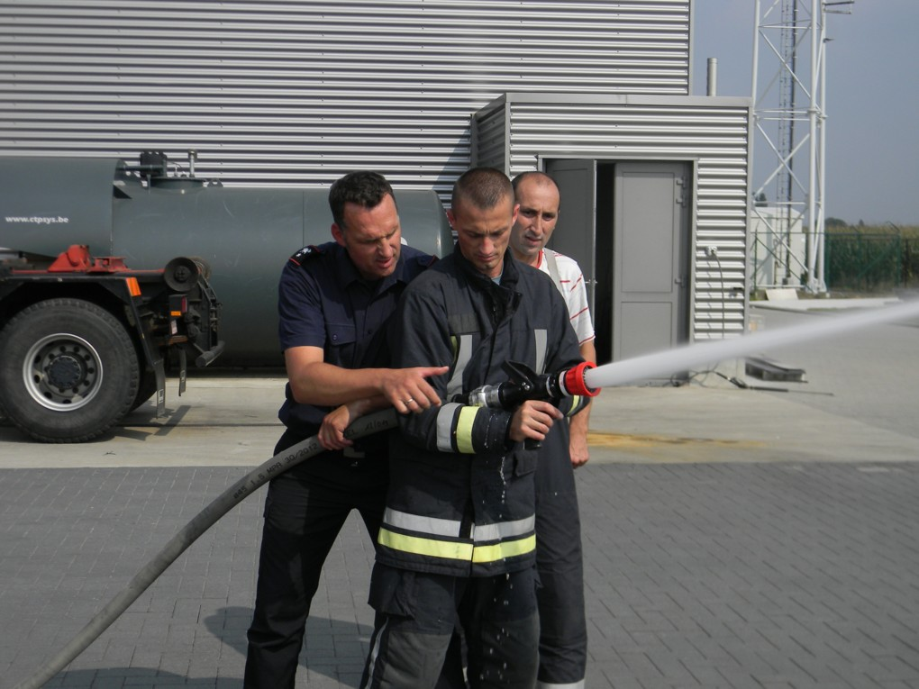
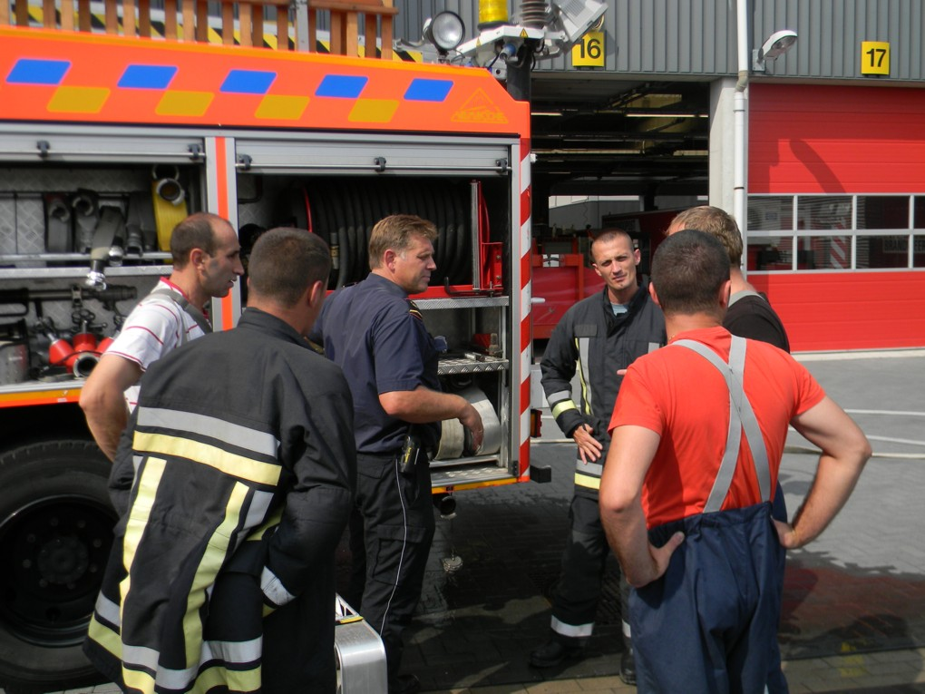
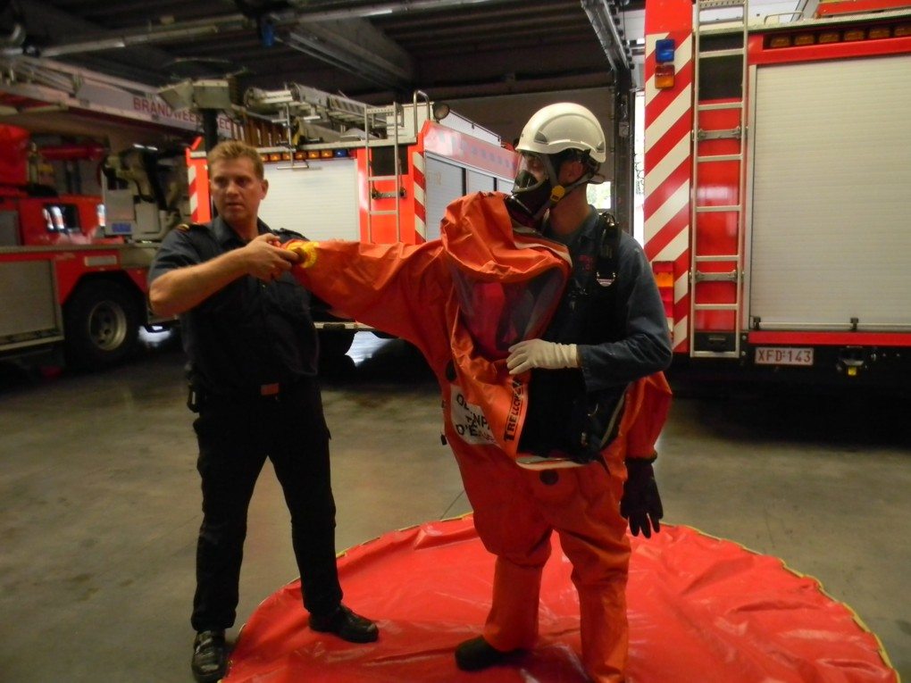
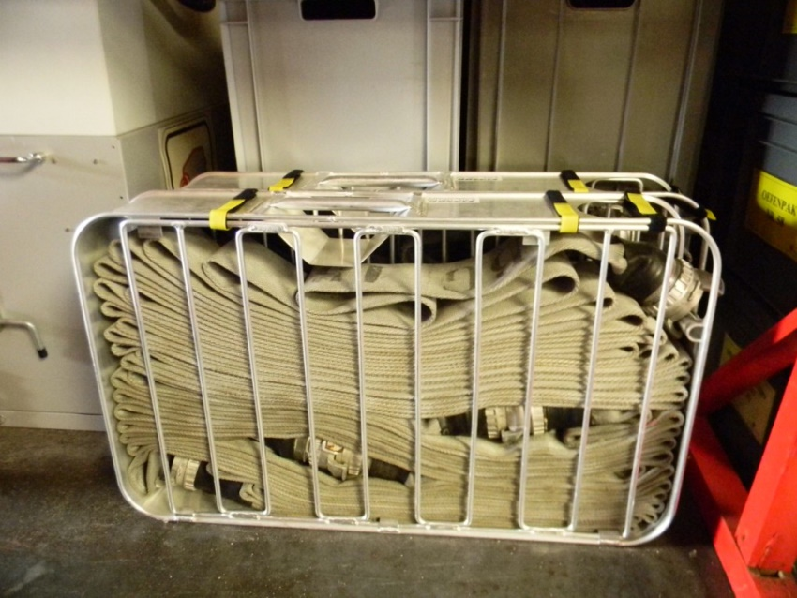
Fire Brigade Geel

Slide 17
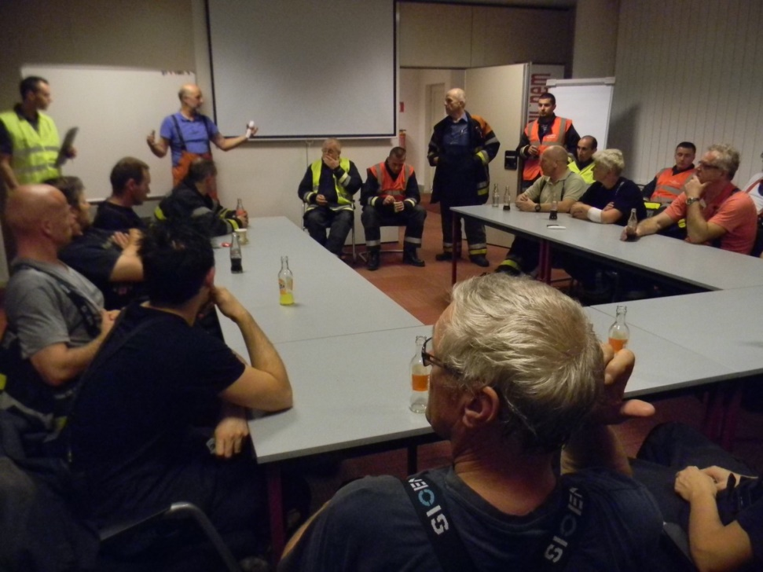
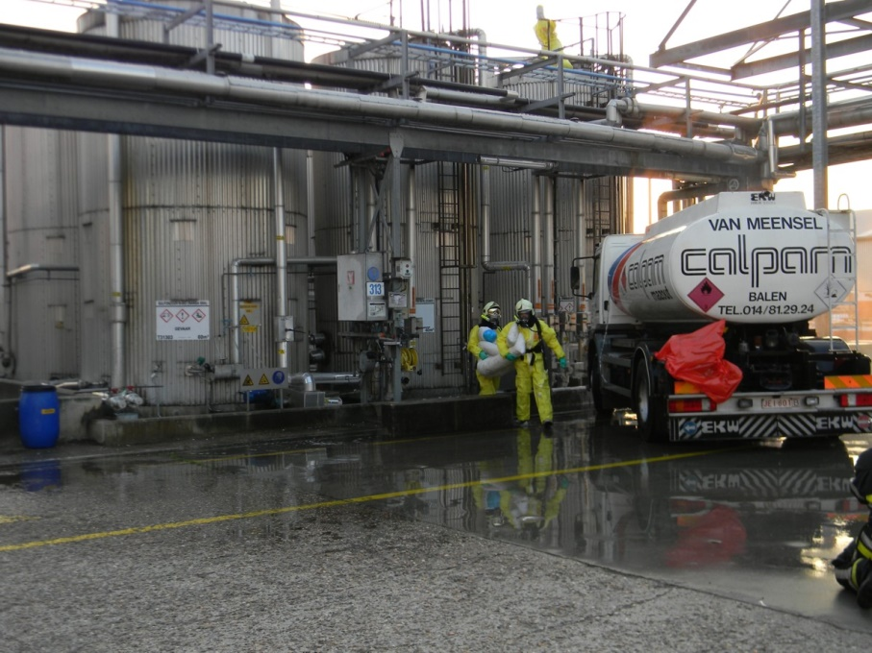
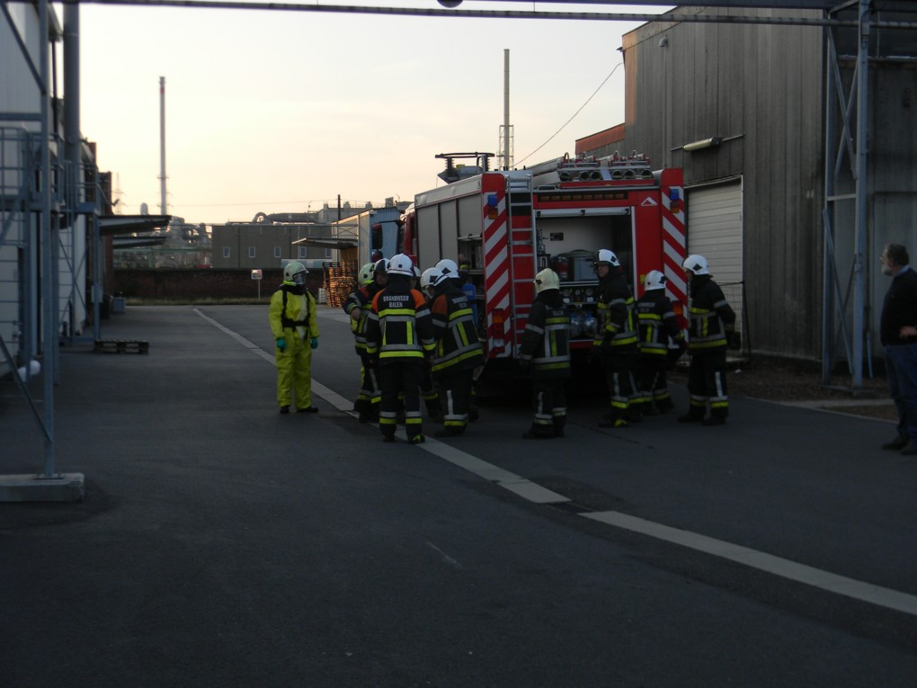
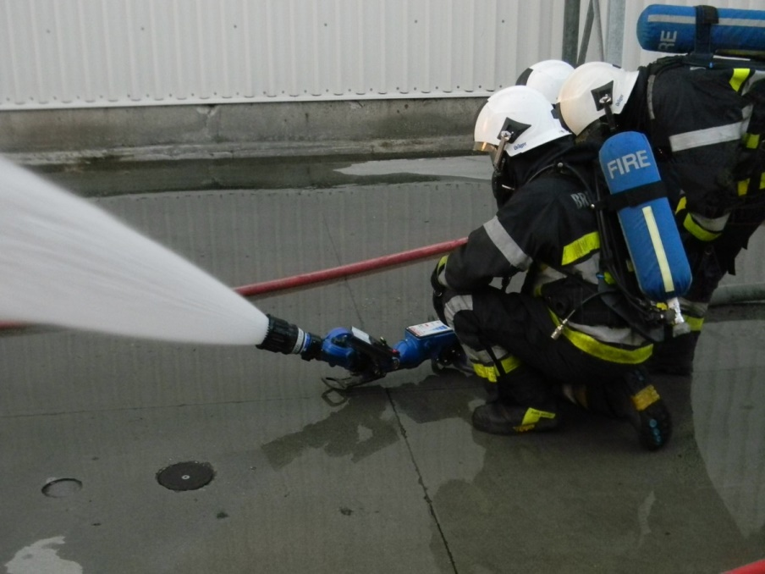
Fire Brigade Balen

Slide 18
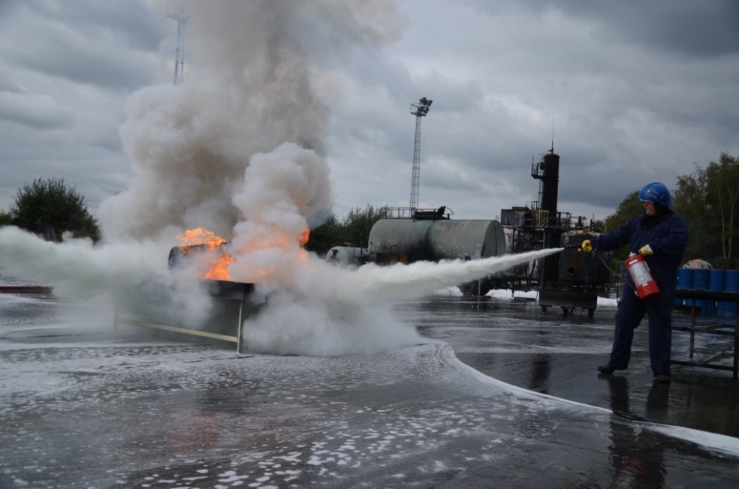
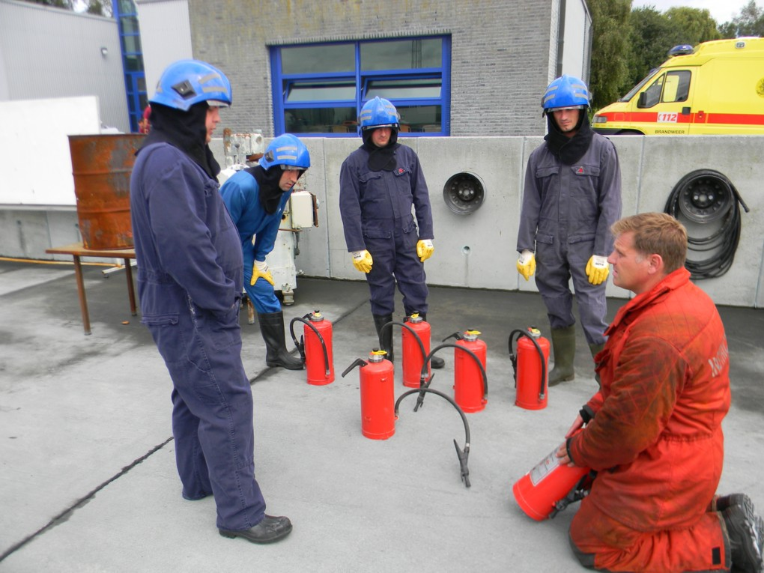
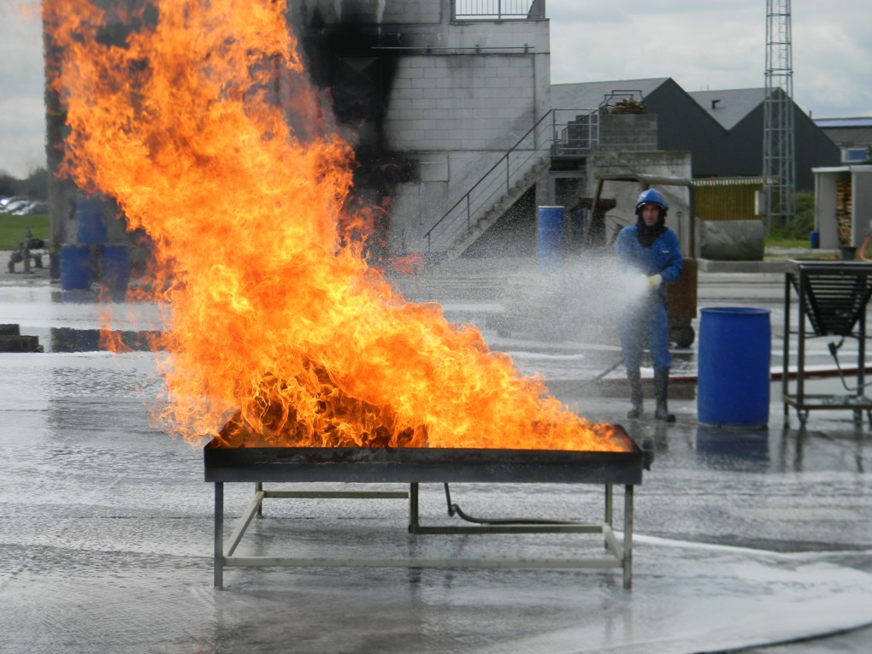
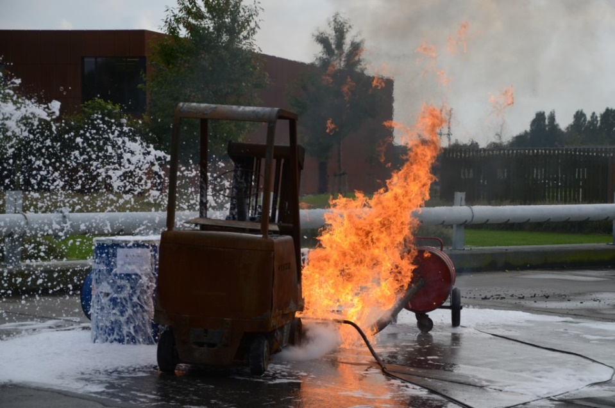
Campus Vesta

Slide 19
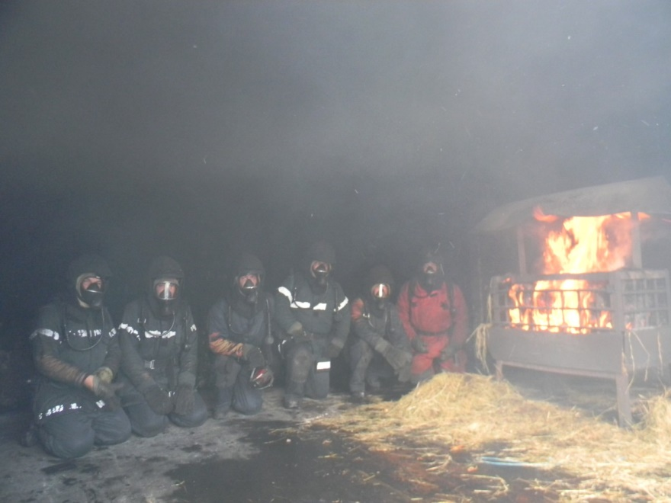
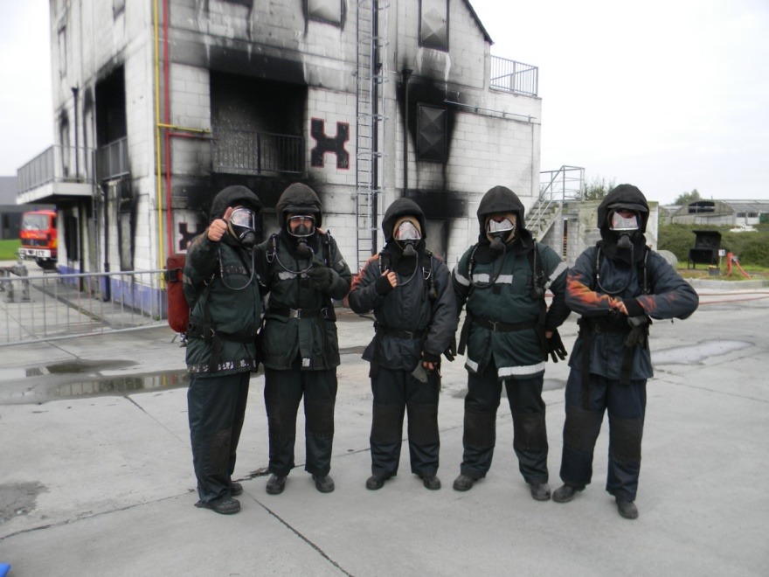
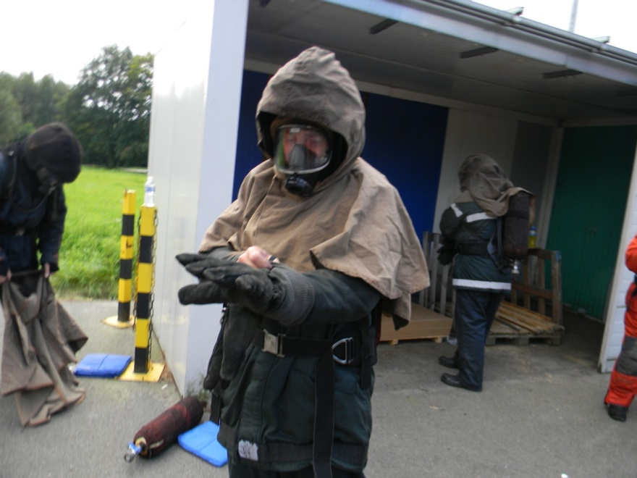
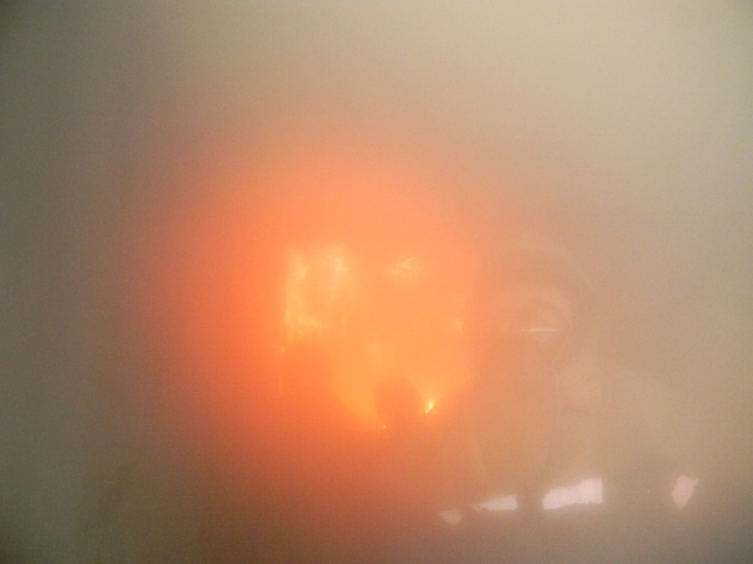
Campus Vesta

Slide 20
Erasmus + project - Proposal
As result of the meeting in 2014 and a meeting at ISU Semenic in Resita 2015 it became clear that there is a big willingness to further support such collaboration.
The idea came to implement an Erasmus+ project “ Train the trainer” for Caras-Severin as pilot project for Romania.
Discussion and Practice: evolution in firefighting o Rapid Fire Progress: backdraft, flashover fire gas ignition. o Safety and fire fighting exercises. o Recognizing imminent hazards during fire.
Cooperation between volunteers and professional corps.
Exchanges between countries.
Prevention: link with schools, society, health centers.
• Training of volunteers and professionals: link with youth unemployment (focus in EU projects).

Slide 21
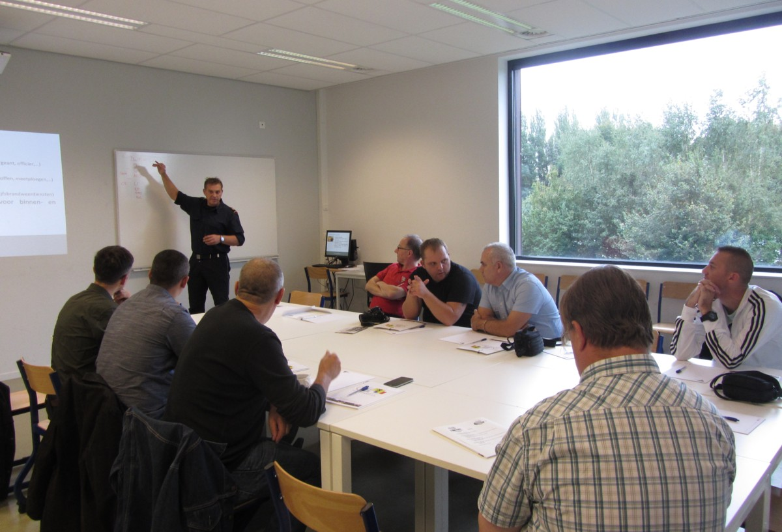
Kick off meeting September 2015
Romanian Participants:
- GĂTEJ. Marius Costin major at the operational center in Bucharest. - BURCIU Costel is Lieutenant Colonel and the chief of the operational center in Reşiţa - MALAESCU Florin is lieutenant and the second in command at the fire station in Reşiţa. - ILIE Cosmin Sorin , Cpt. fire brigade commander Caransebes - MICSA Ovidiu Florin Force Plt. NCO fire brigade Caransebes

Slide 22
Erasmus+ Project
Patrick Van den Nieuwenhof will write the project.
After approval by the participants it ‘ll be submitted in March 2016.
As 3rd country, which is necessary for such a project, a team in Poland is interessed.
Also BIG (Belgian fire fighting info center on dangerous goods) will participate.
We hope that we can tell you next forum about the good results of this project.

